Slide 1
Testing Machine Learning Methods on Emotion Classification Datasets
Tanmoy Sarkar Pias and Jesse Harden

Slide 2
Why Emotion Classification?
Interesting area with diverse applications, such as…
  Detecting confusion in students [1]
  Detecting anger in call-center work [2]
  Enhancing human-robot interaction [3]
Several methods to detect emotions:
  From images
  From EEG Data
We chose to focus on binary emotion classification with EEG data.

Slide 3
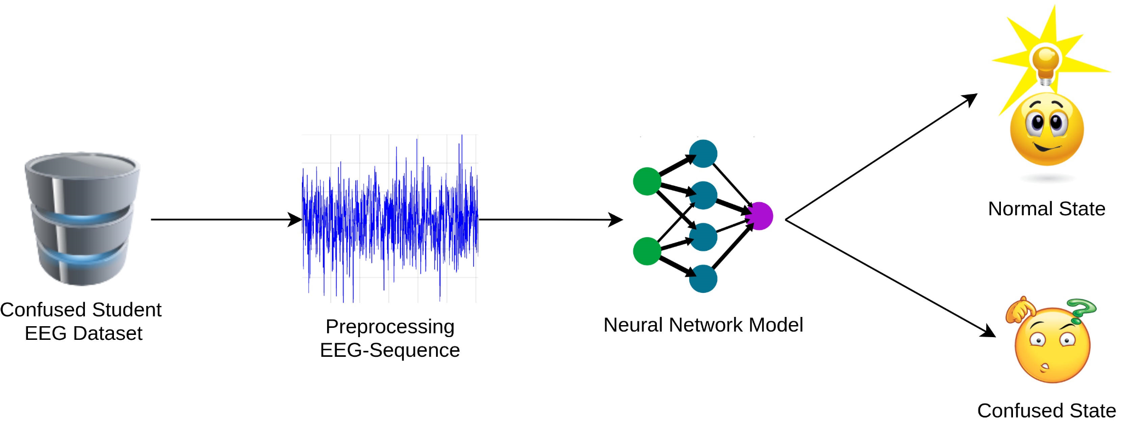
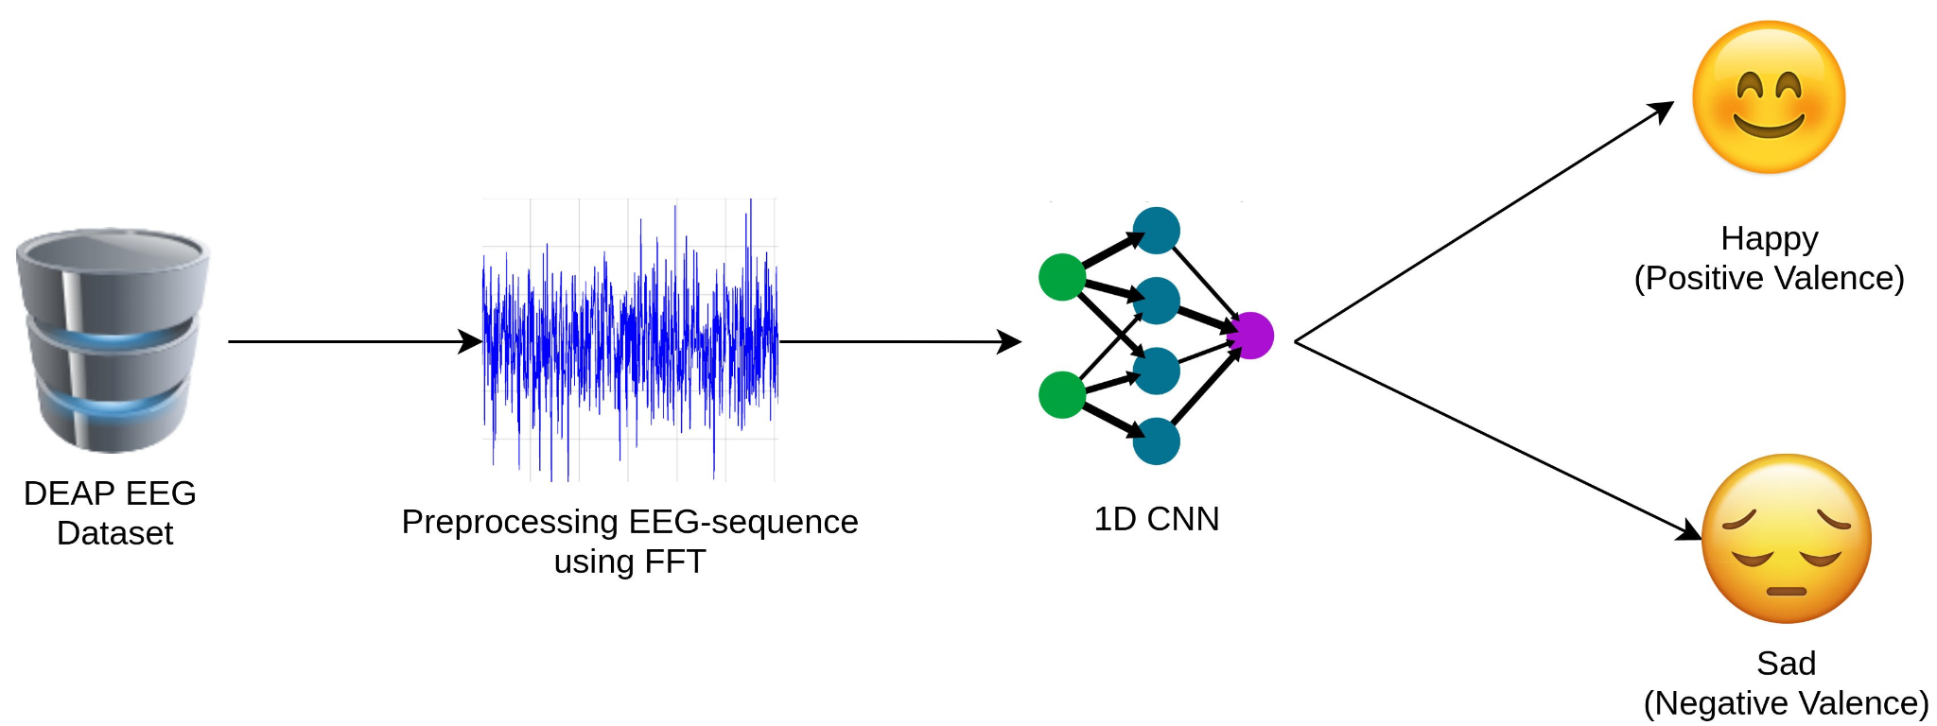
Datasets and Methods

Slide 4
Experiments and Results
Confused Student Dataset Experiments
  SVM barely learned.
  Autoencoders failed to learn.
  LSTMs did okay.
  1D CNNs achieved amazing results.
DEAP Dataset Experiments
  1D CNN, with better architecture, also achieved amazing results.

Slide 5
Final Thoughts
1D CNN's did very well, surprisingly well.
Some Threats to Validity…
  80-20 train test split
  Did not test all methods on DEAP dataset
  What if no good local minimum?
DEAP Dataset Experiments
  1D CNN, with better architecture, also achieved amazing results.

Slide 6
References
H. Wang, Y. Li, X. Hu, Y. Yang, Z. Meng, and K.-m. Chang. Using eeg to improve massiveopen online courses feedback interaction. InAIED Workshops, 2013.
W.-J. Yoon and K.-S. Park. A study of emotion recognition and its applications. InInternationalConference on Modeling Decisions for Artificial Intelligence, pages 455–462. Springer, 2007.
F. Cavallo, F. Semeraro, L. Fiorini, G. Magyar, P. Sinˇcák, and P. Dario. Emotion modelling forsocial robotics applications: a review.Journal of Bionic Engineering, 15(2):185–203, 2018.
S. Koelstra, C. Muhl, M. Soleymani, J.-S. Lee, A. Yazdani, T. Ebrahimi, T. Pun, A. Nijholt, andI. Patras. Deap: A database for emotion analysis; using physiological signals.IEEE transactionson affective computing, 3(1):18–31, 2011.

